Slide 1
Tencent Holdings Cash, Bond and Derivatives
Name
Date

Slide 2
Tencent Holdings Limited
Tencent holdings was founded in 1998 in Shenzhen, China.
In 2004, the company was listed on the Stock exchange of Hong Kong on the Main Board.
Tencent holdings limited is an international tech company.
The company through the use of technology enriches internet users.
The company also assist in upgrading digital services for different enterprises.
Through the communication services and the use of various apps the company connects users of digital content to daily life services in just simple steps of few clicks (Tencent, 2017).
Through the high performance in the various advertising platforms, the company reaches a wide market and high number of clients mostly in China.
Through the technology in financial matters, the company also assists various business by providing relevant services which aids in business growth as well as assistance in digital upgrade.
The company has been consistent in active participation in technological innovations as well as the internet industry developments.

Slide 3
Derivatives
Derivatives are the type of securities that are valued according to the underlying asset based on it.
Therefore the price of the derivative is dependent on the price of the underlying asset meaning that in case of any changes in the price of the underlying asset the derivative changes as well.
Derivatives are in different varieties such as the swaps, options, forwards and futures.
The purpose of these derivatives is to ensure they give manufacturers and producers the possibility to hedge the risks (Císař, & Dufala, 2010). .
Through the use of derivatives the involved parties agree on sale at an indicated price at a specified later date.
Tencent Holdings have used the derivatives in hedging of risks.

Slide 4
Hedging of risks
Tencent is among the companies that have been publicly listed in the mutual funds.
The company have been listed in the American stock exchange market.
Hedging against risks in the entrepreneurship is among one of the most crucial activities used by various companies in worldwide in different industries.
The company has applied the use of derivatives in the hedging of risks especially in the global markets (Taraboulsi, 2018).
Multinational companies and medium to small enterprises have used the strategies to management the risks globally.
Tencent has made efforts through creation of teams who will manage the risks.
The board of directors established the risks available and ensured that the measures have been put in place to ensure any risk is managed.
However if any risk that may occur grows to be beneficial to the company, there is no hedging.
In this regard, the company has prepared to be risk averse.

Slide 5
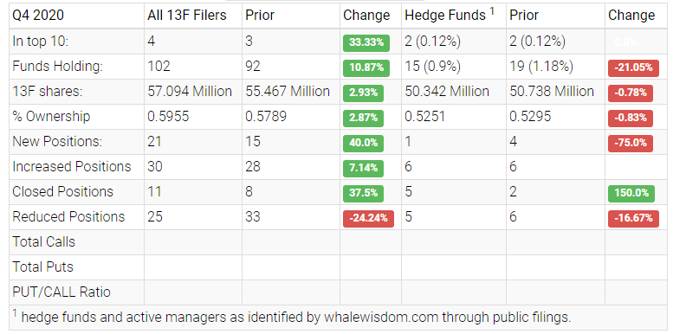
Summary of Hedging in Tencent Holdings Limited

Slide 6
References
Tencent Holdings Ltd. (2020). TCEHY 13F hedge fund and asset management owners. Retrieved April 15, 2021, from https://whalewisdom.com/stock/tcehy
Taraboulsi, R. (2018, December 13). Naspers And Tencent: A Minimum-Risk Hedging Opportunity. Retrieved April 15, 2021, from https://seekingalpha.com/article/4228210-naspers-and-tencent-minimum-risk-hedging-opportunity
Císař, R., & Dufala, V. (2010). Companies and derivates as a tool to hedge their risk.
Tencent. (2017). Tencent. Retrieved April 15, 2021, from https://www.tencent.com/en-us/about.html

